Slide 1
DBSCAN
Grace, Scott, Regina, Hang

Slide 2
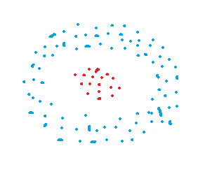
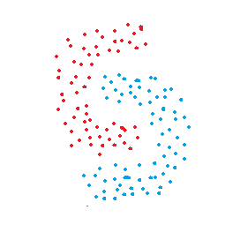
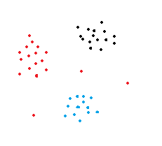
Introduction to DBSCAN
An unsupervised learning method, the algorithm tries to find the underlying structure of the data.
Density-based spatial clustering of applications with noise.
Clusters dataset based on distance between nearest points.
There must be a minimum number of points within that distance of each other to be considered a cluster.
Notes:
Grace

Slide 3
Steps needed for data processing
Required:
Standardization of values so that all features are on the same scale
Missing value imputation/removal
Not required:
Outlier mitigation, as DBSCAN is robust to outliers
Notes:
Regina

Slide 4
Main Hyperparameters
Epsilon (eps): the maximum distance between two points for one to be considered in the neighborhood of the other.
Typically chosen using nearest neighbor graph (k-graph), where k = minPts – 1. Prefer small value of epsilon.
MinPts (min_samples): the number of points (or samples) in a neighborhood for a point to be considered a core point. This includes the point itself.
Must be ≥ 3. As a rule of thumb, minPts = 2 * dimension.
Distance function (metric): need to be chosen appropriately for each dataset. By default, it is the Euclidean distance.
Notes:
Hang

Slide 5
Other Hyperparameters
metric_params: additional keyword arguments for metric (distance function)
algorithm: the algorithm used by the NearestNeighbors module to compute distances and find neighborhood
leaf_size: leaf size passed to BallTree or KDTree (nearest neighbor algorithms), which affects the speed of the query, and the memory needed to store the tree
p: the power of the Minkowski metric (to calculate distance between points)
n_jobs: the number of jobs to run (how many core processors to use)

Slide 6
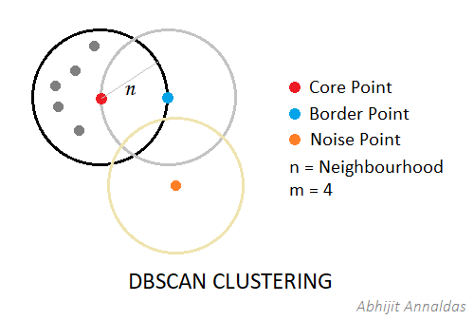
Terms
Core point: a data point is considered a core point if it has the minimum number of neighboring data points (minPts) at an epsilon distance from it.
Border point: a data point that has less than the minimum number of data points (minPts) but has at least one core point in its neighborhood.
Noise point: a data point that is not a core point or a border point is considered noise or an outlier.
Notes:
Scott

Slide 7
Algorithm Steps
Randomly select a point.
If within epsilon distance, there exists points >= minPoints, group these points into a cluster. Else, classify that point as noise.
Iterate through all neighboring points within the epsilon distance and expand the cluster until all points the neighborhood has been visited.
Repeat the process for a new unvisited point, and until all the points in the dataset have been visited.
Notes:
Hang

Slide 8
Advantages​ | Disadvantages​
No need to specify the number of clusters (saves time for trial and error).​ Able to discover clusters of arbitrary shapes.​ Able to detect outliers in the data.​ | Does not work very well for sparse datasets or datasets with varying density.​ Not suitable for high-dimensional data, as distance calculation becomes difficult.​
Notes:
Scott

Slide 9
Conclusion
DBSCAN is an unsupervised learning method.
Determines relationships between data points by forming clusters based on the proximity between the points and the number of points in an area (density of the points).
DBSCAN can work with arbitrary shapes and outliers, but it does not work well with sparse datasets or high-dimensional data.
Applications include: market research, pattern recognition, data analysis, and image processing.
Notes:
Grace

Slide 10
Resources: Questions?
https://towardsdatascience.com/dbscan-clustering-explained-97556a2ad556
https://www.kdnuggets.com/2020/04/dbscan-clustering-algorithm-machine-learning.html
https://www.digitalvidya.com/blog/the-top-5-clustering-algorithms-data-scientists-should-know/
https://towardsdatascience.com/k-means-vs-dbscan-clustering-49f8e627de27
https://towardsdatascience.com/dbscan-clustering-explained-97556a2ad556
https://scikit-learn.org/stable/modules/generated/sklearn.cluster.DBSCAN.html?highlight=dbscan

Slide 11
Appendix
Videos:
Quick explanation of DBSCAN concepts
https://www.youtube.com/watch?v=_A9Tq6mGtLI
Application of DBSCAN and step by step walk through of the algorithm's logic
https://www.youtube.com/watch?v=RDZUdRSDOok
DBSCAN Algorithm | Machine Learning with Scikit-Learn Python:
https://www.youtube.com/watch?v=Q7iWANbkFxk
DBSCAN Clustering for Identifying Outliers Using Python - Tutorial 22 in Jupyter Notebook:
https://www.youtube.com/watch?v=SSFd6UHjxII

Slide 12
Appendix (cont.)
Tutorials/Example Code:
https://scikit-learn.org/stable/auto_examples/cluster/plot_dbscan.html
https://www.machinecurve.com/index.php/2020/12/09/performing-dbscan-clustering-with-python-and-scikit-learn/ (+ additional information)
https://www.geeksforgeeks.org/implementing-dbscan-algorithm-using-sklearn/
https://towardsdatascience.com/dbscan-clustering-explained-97556a2ad556 (+ additional information)
https://becominghuman.ai/dbscan-clustering-algorithm-implementation-from-scratch-python-9950af5eed97
https://towardsdatascience.com/dbscan-algorithm-complete-guide-and-application-with-python-scikit-learn-d690cbae4c5d (+ additional information)

Slide 13
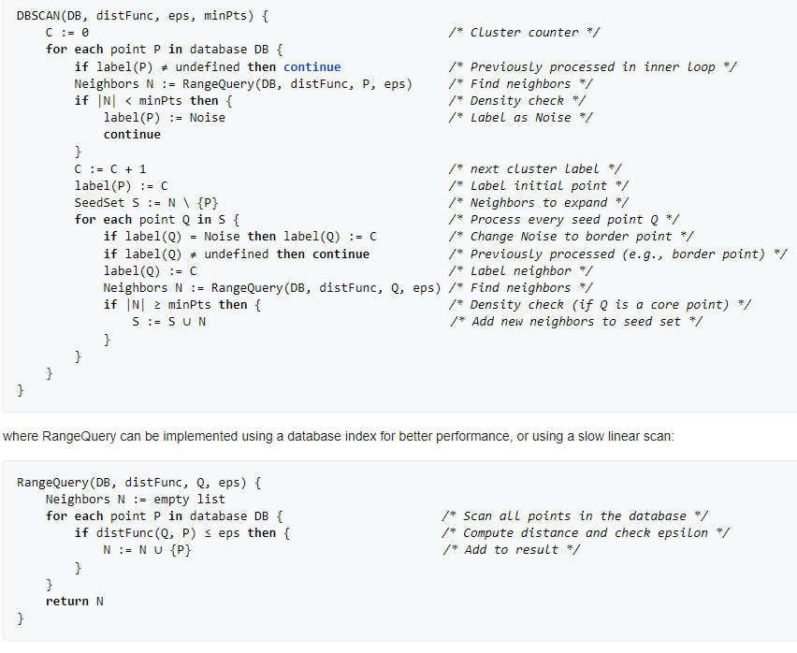
Appendix (cont.) - Pseudocode

